Slide 1


Dear Teachers,
Welcome.
Notes:
Thanks to all of you for finding a way to implement the game with students during a pandemic. You rock. Our game won third place at the European Conference of Game Based Learning’s International Educational Game Competition - so while there still are a few kinks to work out, there are clearly a lot of things to like about our project. Congrats team.

Slide 2
AGENDA
Libra Chat System overview
Guiding Questions and Collaboration Criteria
Rainbow Logic Activity
Q+A and Next Steps
Notes:
The expectation is that you will deliver a collaborative lesson using the Libra chat system with the same students you introduced the game to. The purpose of today's meeting is to model how the chat tool can be used and provide you with all of the materials to use Libra with your students.

Slide 3
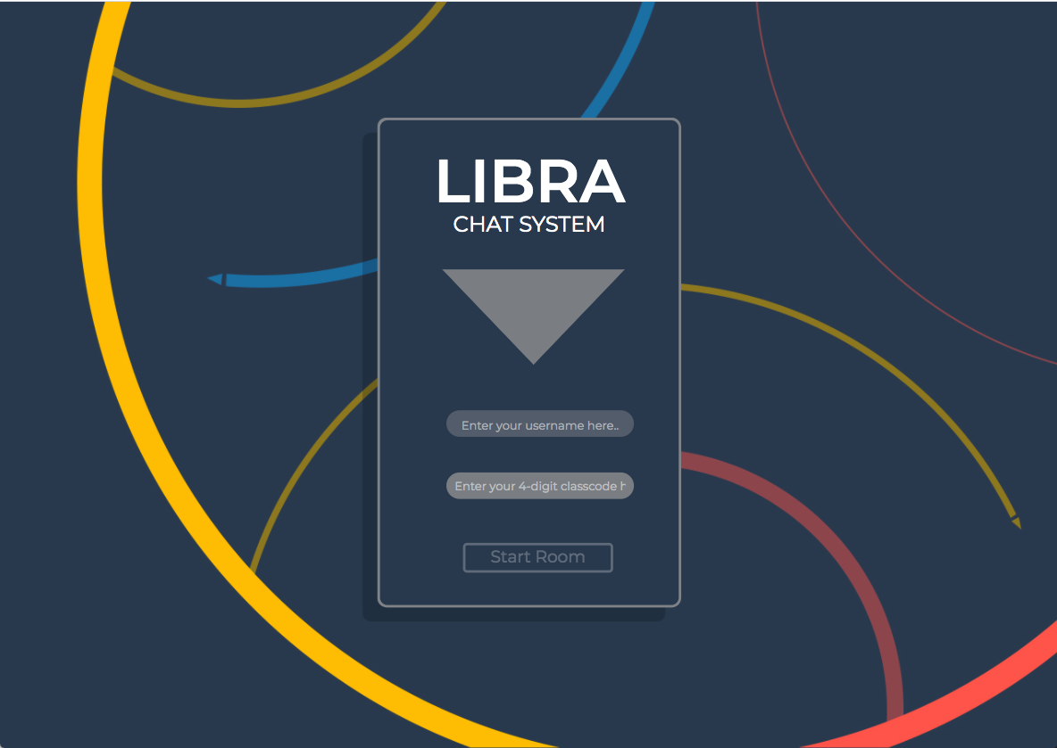
Notes:
First, let’s go over the features of the libra chat system and get everyone logged in.

Slide 4
Name | Code
Jonathan | 0701
Evan | 0701
Seth | 0701
Ahmed | 0702
Richard | 0702
Jordan | 0702

Slide 5
Guiding Questions
How do we communicate effectively in teams?
What patterns of communication do you notice?
What are my strengths and weaknesses when working in groups?
Notes:
Let’s review our guiding questions for the game and chat system. Voiceover questions.

Slide 6

TEAM
Notes:
Recall that LFL had a team aspect as well as an individual aspect. And that this framing is true for the classroom as well, where you have your group to consider when collaborating, but you also have your own personal grade in the class and level of understanding of the content.

Slide 7
What DO teams NEED?
- Trust
- Active Listening
- Patience
- Cooperation
- Shared understanding
- Accepting ideas from others
What DON’T teams WANT?
- Judgement
- Lack of listening
- One person taking control
- Inequity of voice
- Talking over one another
- Being Rude
Notes:
Previously we reflected in the chat on what teams need and don’t want when working together.
These are some of the things you mentioned.
Have two volunteers read each list.

Slide 8
Type a response in the chat - don’t submit yet
What DO teams NEED when trying to communicate?
Notes:
Take 15 seconds to compose a response in the chat. Don’t submit yet, wait until I say submit. (10 sec) OK Submit.

Slide 9
Type a response in the chat - don’t submit yet
What DON’T teams WANT when trying to communicate?
Notes:
Take 15 seconds to compose a response in the chat. Don’t submit yet, wait until I say submit. (10 sec) OK Submit.

Slide 10
Criteria for Collaboration
- Active Listening
- Ask Questions of Peers
- Shares Ideas/Explain Thinking
- Takes a Risk
- Works Persistently
- Uses Resources when Stuck
Notes:
The purpose of the previous questions was to help us develop shared criteria for collaboration. So we can track our progress and get better at working together. This is the list that the teacher advisors for our project have been using and revising.

Slide 11
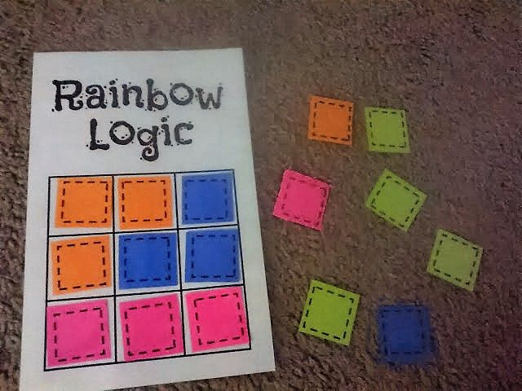
Notes:
For this activity it is best to use colored squares and a game board. You can write colors on bits of paper (they don’t need to be perfect squares for our purposes)
And draw a tic-tac-toe grid. I also made a google sketch - but that is waaay more cumbersome.
Blogpost by Sarah Carter on Rainbow Logic: https://mathequalslove.net/rainbow-logic-activity-to-promote/

Slide 12

Notes:
Rainbow Logic is an activity to promote discussion in group work. Used in Complex Instruction.

Slide 13
Rules
All squares of the same color must be connected by at least one full side
Ask for the colors in a specific row or column
Colors may or may not be given in order
Notes:
Rules
- All squares of the same color must be connected by at least one full side
- Ask for the colors in a specific row or column
- Colors may or may not be given in order

Slide 14
Objective
Discover the hidden grid in as few questions as possible
Notes:
Rules
- All squares of the same color must be connected by at least one full side
- Ask for the colors in a specific row or column
- Colors may or may not be given in order

Slide 15
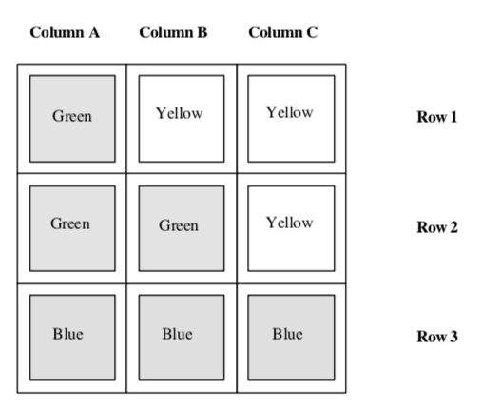
Possible Grid
Notes:
The RL Examples link has this positive example and a few negative examples

Slide 16
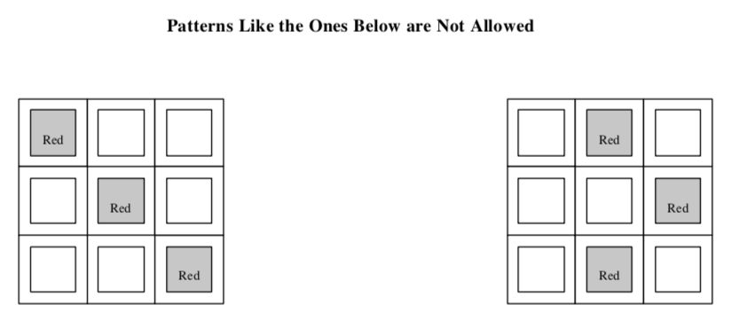
Impossible Grids

Slide 17
Behaviors
- Discuss and Decide
- Give Reasons for your Suggestions
Notes:
The behaviors it promotes are discuss and decide and give reasons for your suggestions

Slide 18
Instructions
- Take turns being the Grid Designer
- Discuss and decide on your questions as a group in Libra
Notes:
Instructions - Take turns being the grid designer
- Discuss and decide on your questions as a group in libra Google Sketch: https://docs.google.com/drawings/d/1IqrCB0Le1H449A5cnUZzg4gVffgAg7ptEmPL-15MCWs/edit?usp=sharing

Slide 19
Debrief
How do patterns in the data relate to how our groups performed?

Slide 20
Chat
What do you need to implement the chat with your own activities?

Slide 21
THANK YOU!

